Slide 1
COMBINING CLASSIFICATION AND BAYESIAN METHODS TO BETTER MODEL DRUG ABUSE
A Thesis Submitted to the Graduate Faculty by
Matthew J. Beattie
December 3, 2018

Slide 2
Topics Covered
Background
Methodology
Dataset Description
Dataset Exploration
Variable Selection
Model Formulation
Bayesian Regression
Conclusion

Slide 3
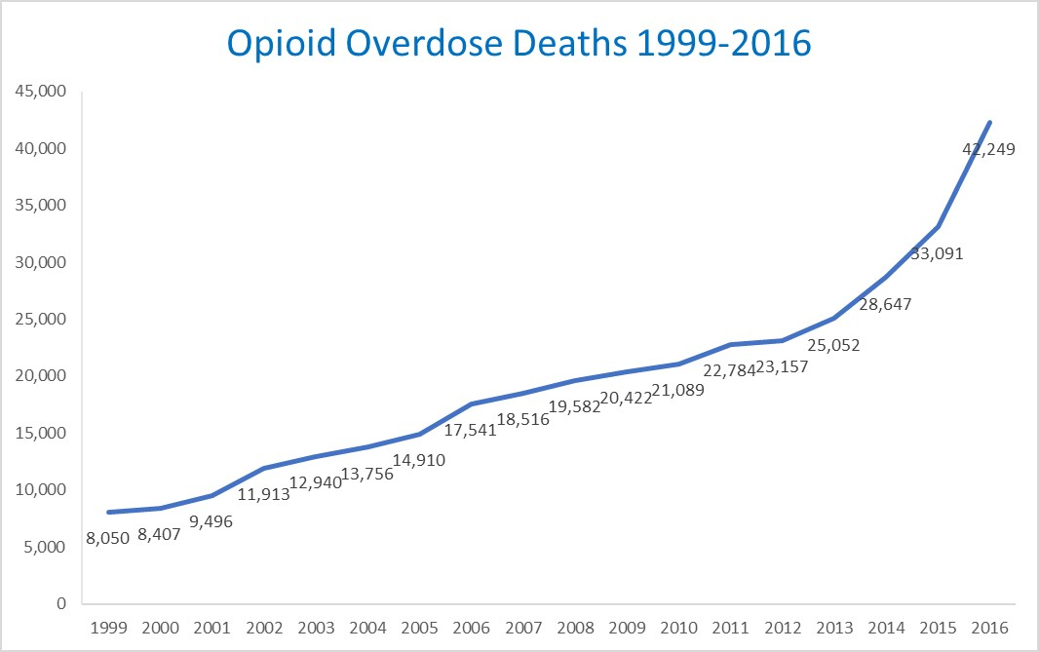
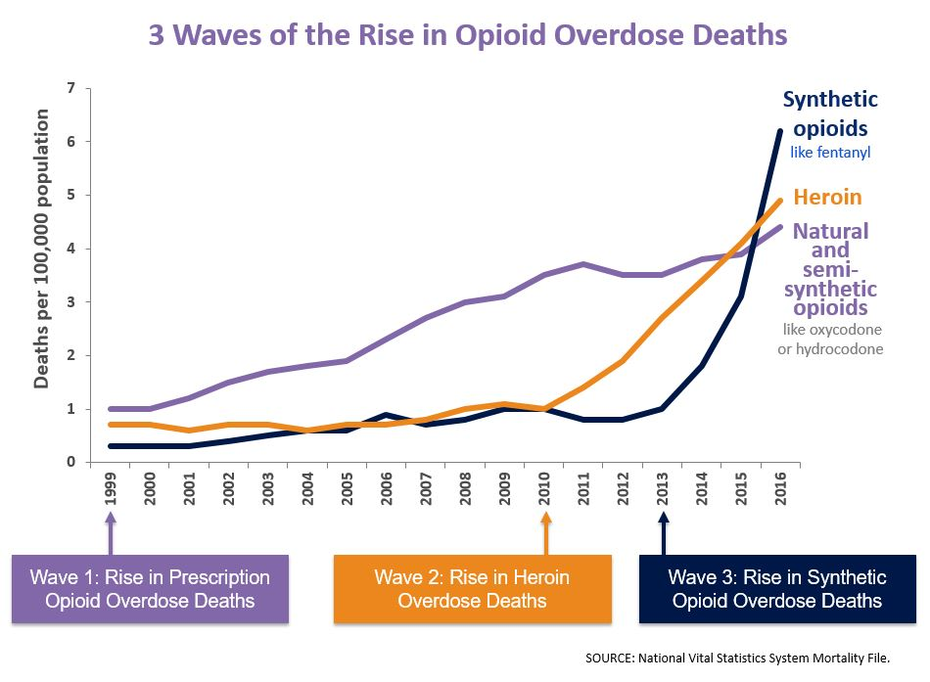
Background
An explosion in the abuse of prescription and non-prescription opioids has occurred since 1999
Deaths from opioid overdose have grown as well, particularly from heroin and synthetic opioids
Finding other correlates to heroin use could lead to intervention strategies
Other studies have identified several links to heroin use

Slide 4
Methodology
Prior Methodology
Limitations
Data sources
NSDUH
Proprietary Data
Clinical Studies
Assumed set of predictors
Null hypothesis significance tests and logistic regression
Production of odds ratios
Researcher bias in hypothesis construction
Premature reduction of datasets
Inability to build upon prior findings

Slide 5
Methodology
Proposed Methodology
Advantages
Multiyear analysis of a massive dataset
Data exploration via principal component analysis
Variable selection via regression trees
Production of odds ratios via Bayesian methods
Consideration of all possible predictors
Guided dataset reduction
Objective variable selection
Incorporation of prior findings
Generation of predictor parameter distributions

Slide 6
Dataset Description
National Survey on Drug Use and Health (NSDUH)
Published by Substance Abuse and Mental Health Svcs Admin (SAMHSA)
National survey since 1971, annually since 1999
Relies on respondents’ answer accuracy
Data from 2003-2014, divided into three-year blocks
Each dataset had approximately 167k observations and 3,625 variables
Manual reduction to 371 variables
Use variables imputed by SAMHSA
Reduce unnecessary categorization variables that duplicated information
Consolidated rare-drug variables that were also represented in groups of drugs
Reduction of missing data via manual imputation

Slide 7

Dataset Exploration
Look for opportunities for dataset consolidation via PCA
First pass on the data resulted in a split between adult and youth cohorts
Subsequent passes identified variables with high degrees of similarity or correlation that could be consolidated
PCA is the process of finding a basis for the covariance matrix of the dataset. Each eigenvalue represents the variance in the data explained by its corresponding eigenvector.

Slide 8
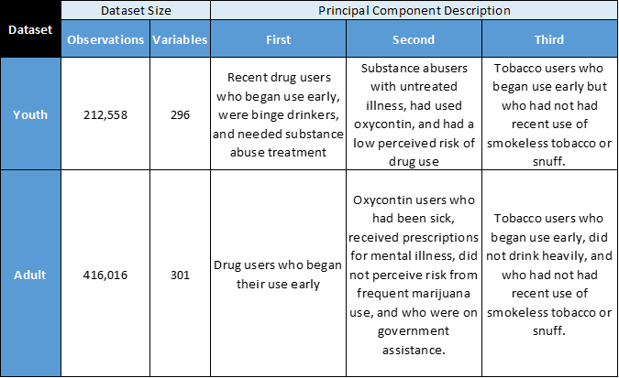
Dataset Exploration
Separation of dataset into adult and youth cohorts
Consolidation of physical and mental health flags
Consolidation of variables for specific reasons for avoiding treatment
Identification of redundant drug use flags

Slide 9
Variable Selection: Methodology
Conditional Inference Trees
Random Forest
Modification of Classification and Regression Trees (CART)
Two steps
Check for a variable that is linked to the response via significance testing (if none then stop)
Find the optimal value of the variable to split the data into two ideally homogenous sets
Method avoids effects of variables with many values
Single tree models are unstable
Bagging: bootstrap samples from dataset and average trees of the samples
Random predictor selection: randomly choose predictors at each step of tree generation
Result is a more stable solution with diverse tree structures
Useful for variable importance assignment

Slide 10
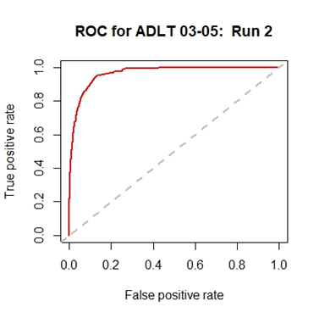
Variable Selection: Methodology
Multiple runs conducted on the 2003-2005 dataset to optimize tuning parameters
Best parameters used for runs for other years

Slide 11
Variable Selection: Sample Results

Slide 12
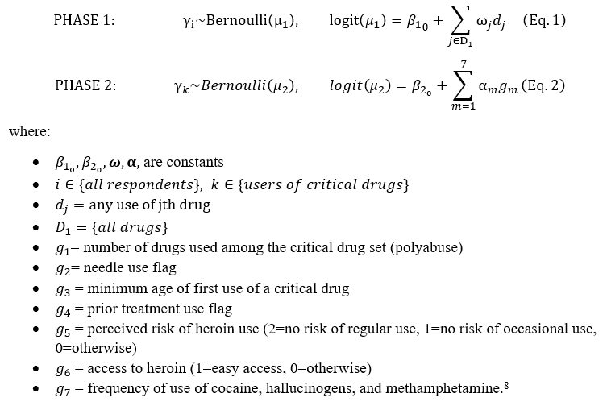
Model Formulation
To simplify regression, we select a common set of variables for the models for different years
Variables fall into several groups
Variable selection results in a two-phase model
Variable Category
Drug Use Flags
Access to Heroin
Perceived Risk of Heroin Use
Age of First Use of Specific Drugs
Needle Use
Prior Substance Abuse Treatment
Frequency of Use of Specific Drugs

Slide 13
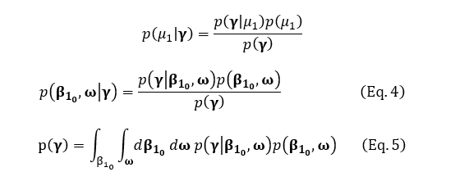
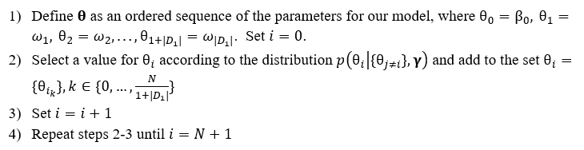
Bayesian Regression (Phase One Example)
The model is written in terms of Bayes Rule
To avoid the difficulty of evaluating the integral in the model, we use Gibbs Sampling

Slide 14
Setting the Priors
Greenland’s Definitions
Uncertain Direction: mean OR of 1, 95% certainty (1/4, 4)
Normal Distributions (mean, variance)
Probably Positive: mean OR of 2, 95% certainty (1/2, 8)
Probably Strong: mean OR of 4, 95% certainty (1,16)
Uncertain Direction: Normal (0, 0.5)
Probably Positive: Normal (0.6931, 0.5)
Probably Negative: Normal (-0.6931, 0.5)
Probably Strongly Positive: Normal (1.396, 0.5)
Probably Strongly Negative: Normal (-1.396, 0.5)
Approach described by Greenland
Subjective Priors using clinicians’ terminology
Subjective Priors are thought of as odds ratio (OR) “bets”
We convert the bets to probability distributions

Slide 15
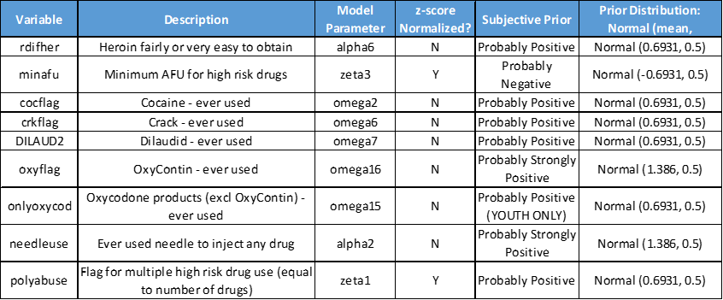
Setting the Priors
Evidence for the Subjective Priors comes from literature search
Studies based upon NSDUH are excluded from the search to avoid double counting data
Strength of evidence is subjective
High odds-ratios in other studies
Multiple studies with reinforcing conclusions

Slide 16
Adult Results
OxyContin’s association with heroin use has grown consistently over 12 years.
Cocaine and crack have consistently had the highest ORs, possibly due to concurrent usage
Needle use and access to heroin are most correlated with heroin use
AFU was either null or negligible

Slide 17
Youth Results
Cocaine and crack were most associated with heroin use.
Fewer drugs were critical for youths than for adults
Needle use and access to heroin had the highest ORs
Frequency and AFU were null or negligible

Slide 18
Revised Models
The removal of Frequency and AFU from the original models allows inclusion of all respondents
The rank of factors is fairly consistent over time for adults
Polyabuse increases steadily and Needle Use decreases steadily as factors for youths over time

Slide 19
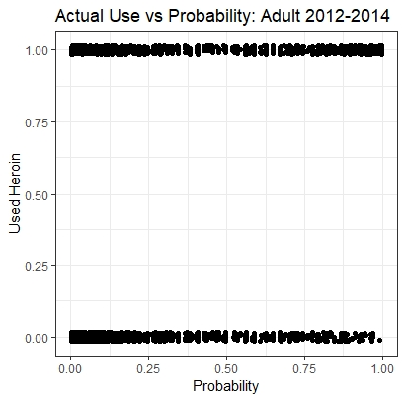
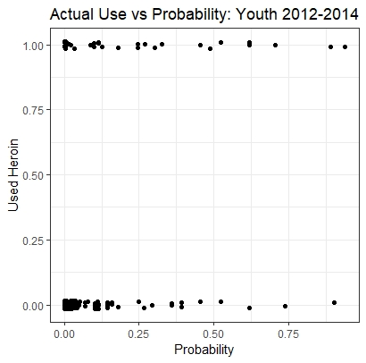
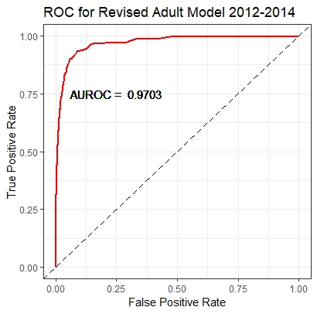
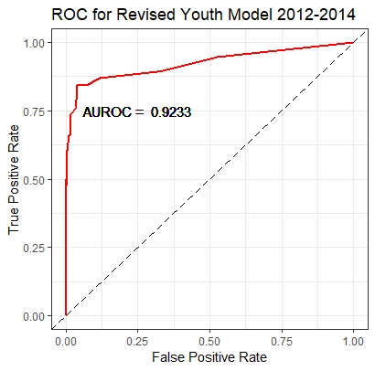
Model Validation
Distribution of predicted usage follows probability of use
AUROC scores for both adult and youth models are above 0.90

Slide 20
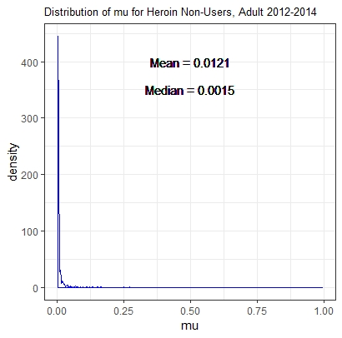
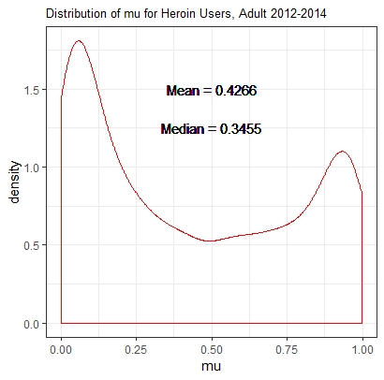
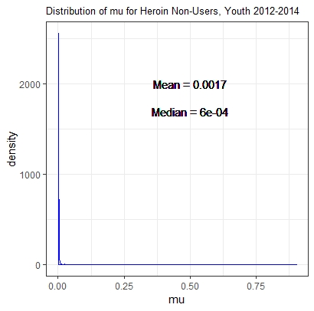
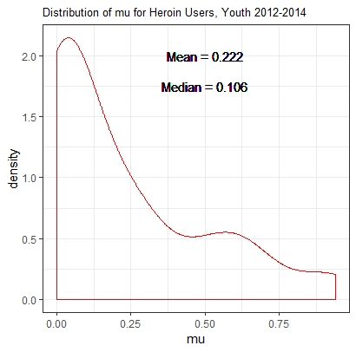

Model Validation
Means for the model probability of heroin use ($μ$) are much higher for actual users
When used for classification, threshold values for $μ$ are relatively low

Slide 21
Conclusions
The combination of PCA, CART, and Bayesian Regression is a powerful process for exploring large, complex medical datasets
Subjective Priors enable researchers to incorporate previous studies , even limited ones, into new models
We have definitively determined strong correlates to heroin use, including specific drugs and usage patterns
Our model can provide practitioners with a scoring methodology for intervention therapy

Slide 22
Directions for Future Research
The dataset is a limiting factor of this study – it is based upon respondents’ knowledge or honesty. Complementary studies based upon admissions and insurance data could be done.
This study finds correlations, not causality. Focusing on AFU variables could help portray evolution of use.
The study does not suggest strategies for reversal of the epidemic. One potentially interesting line of research would be on adjacency theory.
Despite its limitations, there are actions from this research that should be taken – the speed of evolution of the drug epidemic precludes exhaustive study of the problem.

